Slide 1
Chapter 5 Process API
Chien-Chung Shen
CIS/UD
cshen@udel.edu

Slide 2
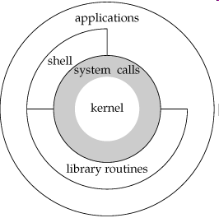
Process API
Practical aspects of OS – system calls and how to use them
Process creation in Unix – via a pair of system calls [fork() and exec()]
why? (ease of use and utility)

Slide 3
fork()System Call
Child process that is created is an (almost) exact copy of the calling (parent) process
both parent and child are about to return from fork()
Child doesn’t start running at main(); it just comes into life as if it had called fork() itself
The value child process returns to the caller of fork() is different from the value parent process returns to its caller of fork()
Either parent or child would run next (on a single CPU) – not deterministic (an concurrency issue)

Slide 4
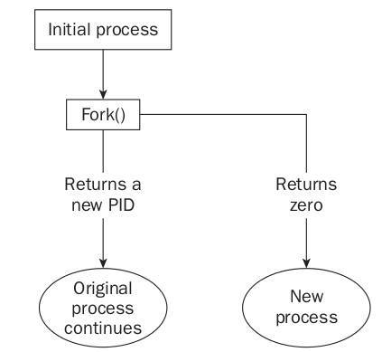
parent
child
time

Slide 5
parent
child
fork() fork()
wait()
time

Slide 6
wait()System Call
Allow a parent process to wait for a child process to “finish”
Make the relative execution order of parent and child more deterministic
if the parent does happen to run first, it will immediately call wait() (to delay its own execution); this system call won’t return until the child has run and exited*
when the child is done, wait() returns to the parent

Slide 7
exec()System Call
Loads code (and static data) from specified executable and overwrites its current code segment (and current static data) with it
Heap and stack and other parts of the memory space of the program are reinitialized
Does not create a new process; rather, transforms the currently running program into a different running program
A successful call to exec() never returns

Slide 9
Why fork() and exec() ?
Separation of fork() and exec() is essential in building a Unix shell
It lets shell run code after the call to fork() but before the call to exec()
the code can alter the environment of the about-to-be-run program, and thus enables a variety of interesting features to be readily built (in a shell)
e.g., redirection ($ wc p3.c > newfile.txt)
when child process is created, before calling exec(), the shell closes standard output (1) and opens file newfile.txt
by doing so, any output from the soon-to-be-running program wc are sent to the file instead of the screen
Assumption: Unix starts looking for free file descriptors at zero (0) and STDOUT_FILENO will be the first available one

Slide 10
The “trick” is used to implement
prompt> wc p4.c > ./p4.output
in Unix shell
file descriptor STDOUT_FILENO (1) becomes free/available
assign first free/available file descriptor (1) to ./p4.output

Slide 11
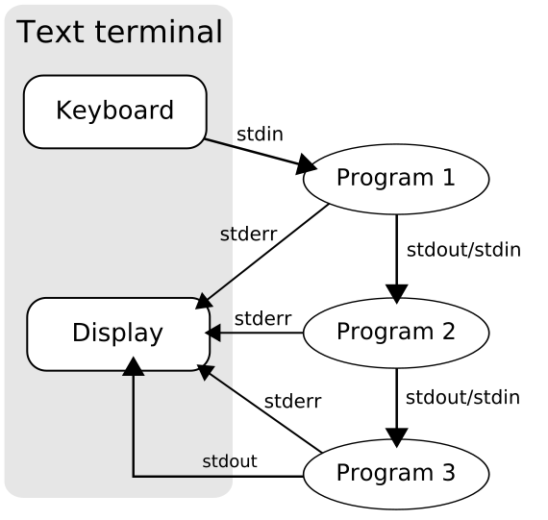
From Redirection to Pipe
prompt> wc p4.c > ./p4.output
prompt> ls | grep chapter | wc -l

Slide 12
Process Control and Users
kill() system call sends signals to a process, including directives to pause, die, and other useful imperatives
In most Unix shells, certain keystroke combinations are configured to deliver a specific signal to the currently running process
control-c sends a SIGINT (interrupt) to the process (normally terminating it)
control-z sends a SIGTSTP (stop) signal thus pausing the process in mid-execution
resume it later with fg built-in command

Slide 13
Process Control and Users
The entire signals subsystem provides a rich infrastructure to deliver external events to processes, including ways to
receive and process signals within individual processes
use signal() system call to “catch” various signals and run a particular piece of code in response to the signal
send signals to individual processes as well as entire process groups [try to kill ./sleep running within your shell implemented without calling signal]
Who has the right to send signals to whom?
Notion of user
a user generally can only control her/his own processes

Slide 14
Other System Calls and Commands
kill(): send signals to process
ps
top
man <topic>

Slide 15
More Readings
Stevens and Rago’s “Advanced Programming in the UNIX Environment” book: chapters on Process Control, Process Relationship, and Signals
All nuances and subtleties of using Unix APIs are found herein. Buy this book! Read it! And most importantly, live it.

